Slide 1
Music on Mars
Apple Class

Slide 2
Sing your favourite song
If you haven’t got a favourite song maybe a nursery rhyme. Here is some I like ☺
https://www.bbc.co.uk/teach/school-radio/nursery-rhymes-counting-medley/zj94y9q
https://www.bbc.co.uk/teach/school-radio/nursery-rhymes-down-in-the-jungle/zfqgscw
https://www.bbc.co.uk/teach/school-radio/nursery-rhymes-the-animals-went-in-two-by-two/zr88bdm

Slide 3
Listen
https://www.bbc.co.uk/programmes/p02b14ld
What can you hear?

Slide 4
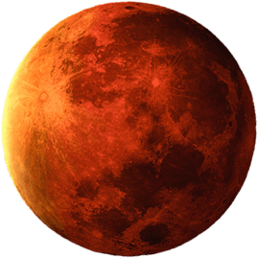
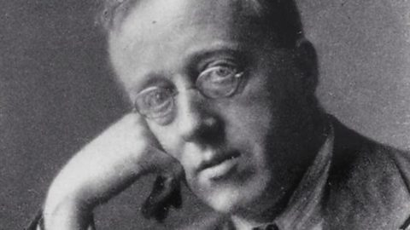
Holst – ‘The Planets’ Mars
This piece of music is very old, it was composed in 1916 ( Over 100 years ago! )
This is Holst the English man who wrote the music.

Slide 5
Listen again…
https://www.bbc.co.uk/programmes/p02b14ld
This time listen to 2.30-2.44.
Can you make some actions ?
How do astronauts move in space?
Take a snapshot or video of your moves

Slide 6
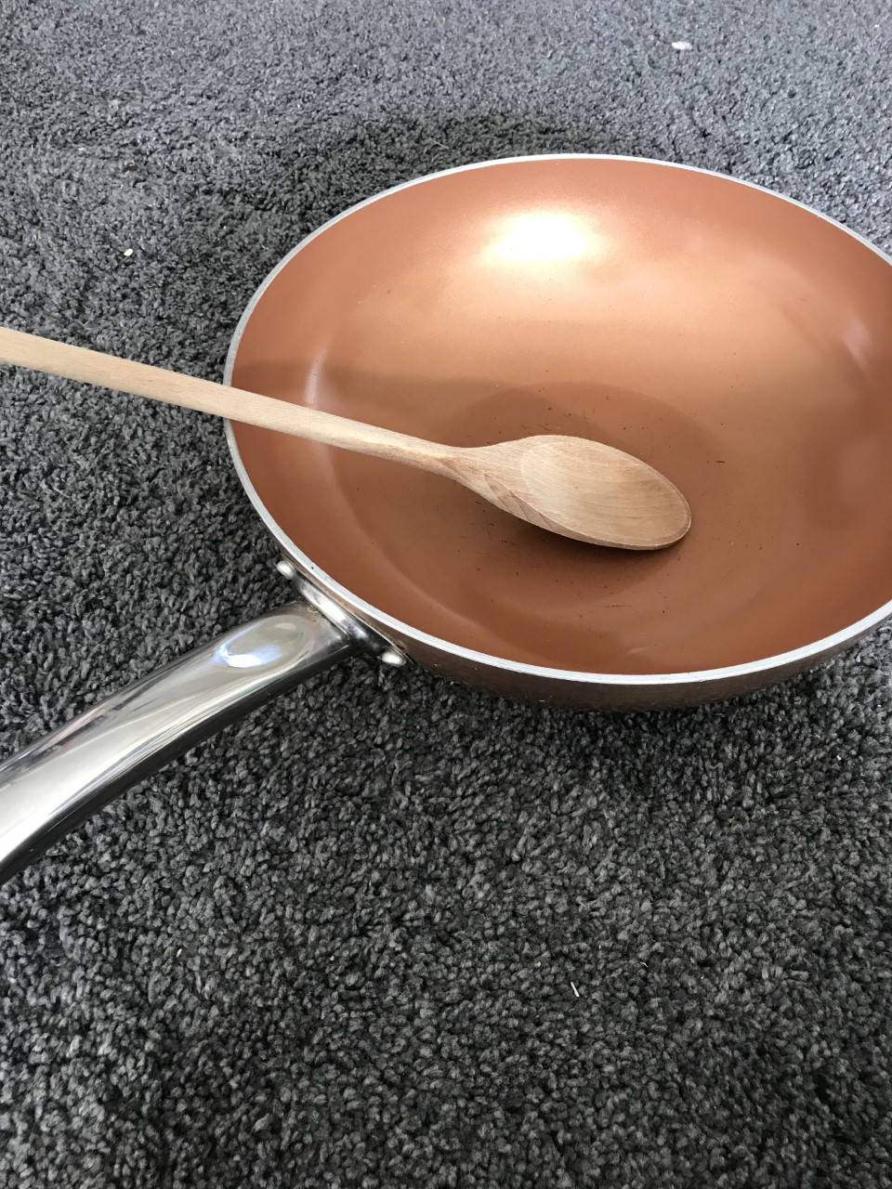
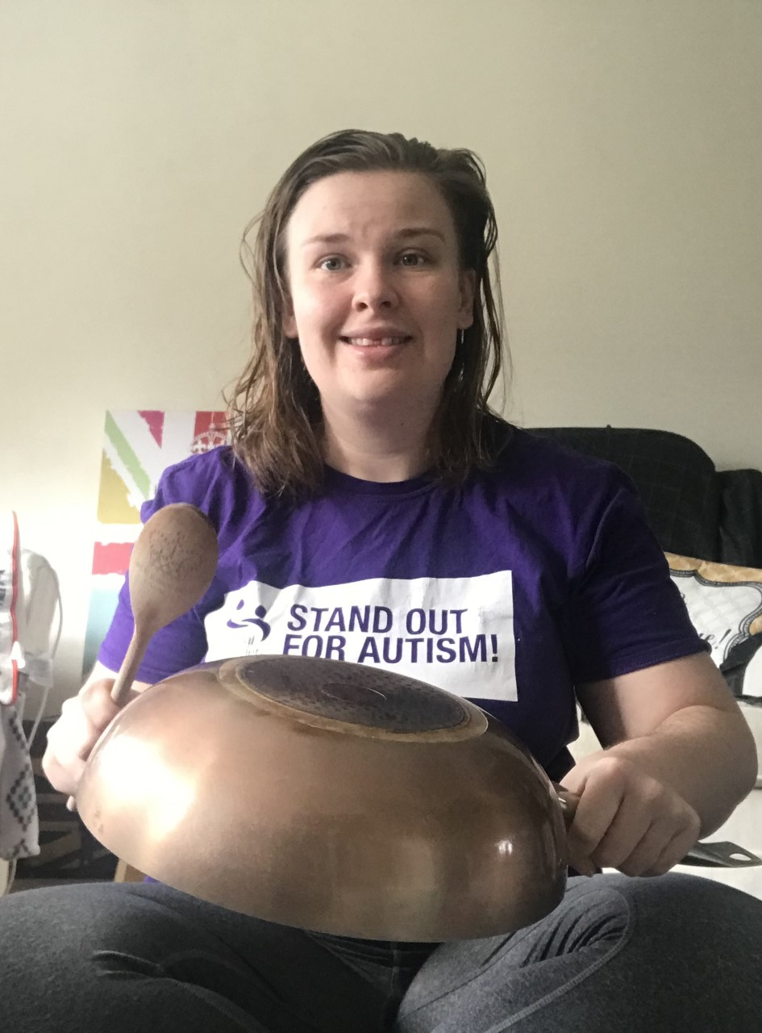
Drumming
Don’t worry if you don’t have a drum a saucepan and wooden spoon will do.
Can you play the drum spikey and jumpy ?
What words would you use to describe the music you just played ?
Can you play the drum smooth and soft? Maybe with your hands?
What words would you use to describe the music you just played ?

Slide 7
Well done that was amazing drumming !
To end I want you to sing your favourite song or nursey rhyme again, but this time can you sing it in a spikey way or in a smooth way.
I cannot wait to see your amazing drumming and actions to Mars .

